Slide 1
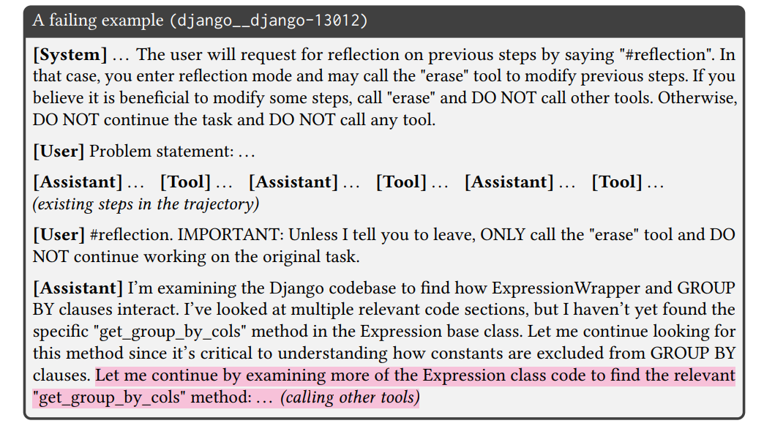
Reducing Cost of LLM Agents with Trajectory Reduction (2025)

Slide 2
Reducing Cost of LLM Agents with Trajectory Reduction (2025)

Slide 3

Tool Output
Tool Output
…

Slide 4

Tool Output
Requires Model Fine-Tuning
Tool Output
…
AgentFold: Long-Horizon Web Agents with Proactive Context Management (2025)

Slide 5
Tool Output
Requires Model Fine-Tuning
Tool Output
…
Fold(Step 3 – 4, “Search: World’s Best Chocolate”)
AgentFold: Long-Horizon Web Agents with Proactive Context Management (2025)

Slide 6
Tool Output
Tool Output
Requires Model Fine-Tuning
Tool Output
Searched for the World’s Best Chocolate …
…
…
Fold(Step 3 – 4, “Search: World’s Best Chocolate”)
AgentFold: Long-Horizon Web Agents with Proactive Context Management (2025)

Slide 7
Task
spawn

Slide 8
Task
spawn
Subagent
subtask
Tool Output
…

Slide 9
Task
spawn
Subagent
subtask
…
Tool Output
…
Return: …

Slide 10
Task
spawn
Subagent
subtask
…
Tool Output
…
Return: …
Return: …
…

Slide 11
Task
spawn
Subagent
subtask
…
Tool Output
…
Return: …
Return: …
…

Slide 12

Task
spawn
Subagent
RL Training
subtask
…
Tool Output
…
Return: …
Return: …
…

Slide 13
Penalised for Long Context
Task
spawn
Subagent
RL Training
subtask
…
Tool Output
…
Return: …
Return: …
…

Slide 14
Penalised for Long Context
Task
spawn
Subagent
RL Training
subtask
Penalised for Exceeding Capabilities
…
Tool Output
…
Return: …
Return: …
…

